Slide 1
Dimensional reduction, feature selection and clustering techniques
Alex Rodriguez
International School for Advanced Studies (SISSA), Trieste, Italy

Slide 2
Outline
Motivation for Clustering
Feature selection and Dimensional reduction
Similarities and Distances
Flat, fuzzy and Hierarchical clustering methods
K-means clustering
Notes:
Clustering applications must be done…

Slide 3
Motivation for clustering
Summer School on Machine Learning in the Molecular Sciences
Notes:
I should give this part much more relaxed and much more slow

Slide 4
What is a cluster???
Structure underlying your data
Notes:
Explain what the hell is a cluster, probably is better if I add other examples

Slide 5
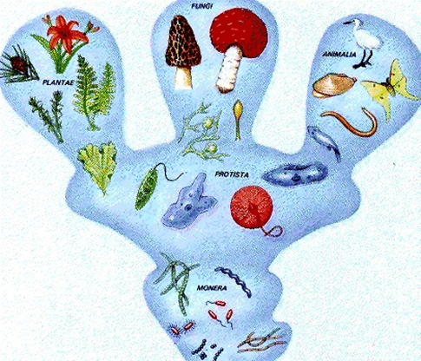

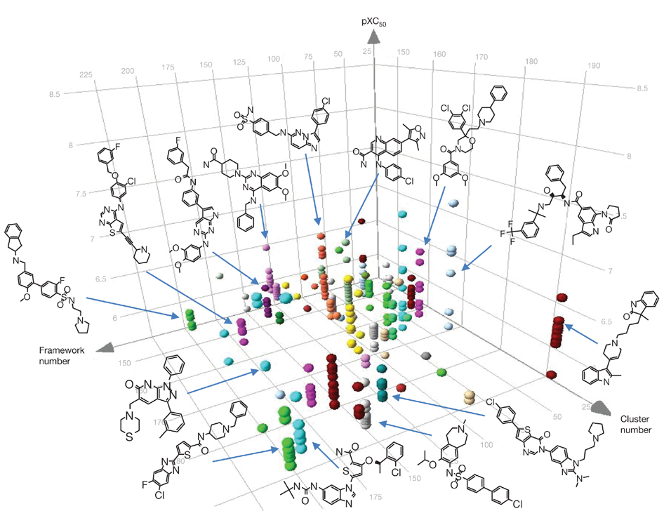
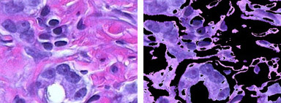
Data mining tool that can be used for:
Decide which set of drugs from a big library we should synthetize and test.
WWW (googling…)
Image recognition
Classify plants, animals (biology), books(libraries), everything …

Slide 6
Why Clustering?
“Understanding our world requires conceptualizing the similarities and differences between the entities that compose it” (Tyron and Bailey, 1970).
Clustering ≠ Classification
Clustering generate groups
Classification generate groups & labels
Unsupervised learning

Slide 7
Clustering and MD
How to make sense of
this amount of information?
Elber, R., & Karplus, M. (1987). Multiple conformational states of proteins: a molecular dynamics analysis of myoglobin. Science, 235(4786), 318-321.

Slide 8
Clustering procedure
Data Samples
Feature Selection (objective related)
Clustering
Knowledge
Interpretation (Expertise)
Validation (are the groups meaningful?)
Notes:
Explain slowly all the steps

Slide 9
Characteristics of the data sample
Raw characteristics:
Number of features (Dimension)
Number of samples (Cardinality)
Type of features (Reals, integers, binary, qualitative)
Learned characteristics:
Statistics (Variances, covariances, averages…)
Intrinsic dimension.
Clustering…
Notes:
Put a data set example.

Slide 10
My stone collection
Integer
Categorical
Real
Number | Weight (g) | Wavelenght (nm) | Shape | Volume | Rugosity
1 | 20 | 450 | spherical | 0,2 | 1,04
2 | 33 | 698 | cube | 0,4 | 1,3
3 | 12 | 543 | cube | 0,2 | 0,8
4 | 70 | 691 | spherical | 1,1 | 1,9
5 | 120 | 465 | cube | 0,3 | 0,2
6 | 45 | 486 | cube | 0,8 | 0,3
7 | 136 | 504 | cube | 1,35 | 0,5
8 | 20 | 504 | spherical | 0,2 | 0,5
9 | 54 | 623 | spherical | 0,5 | 1
10 | 93 | 430 | spherical | 0,7 | 1
….

Slide 11
Feature Selection
Summer School on Machine Learning in the Molecular Sciences

Slide 12
Feature Selection & Dimensionality reduction
Highly related with the problem that we want to solve
It may need feedback from the whole process
Feature selection usually depends on labeled data (semi-supervised clustering) while dimensionality reduction does not.
Feature selection can be based on expertise…

Slide 13
Feature selection
Features
Ground Truth
Try to extract which features contain relevant information for reproducing the ground truth classification

Slide 14
Techniques for Feature Selection (1) Variable Ranking
Which variables explain better the labels? Quantify it.

Slide 15
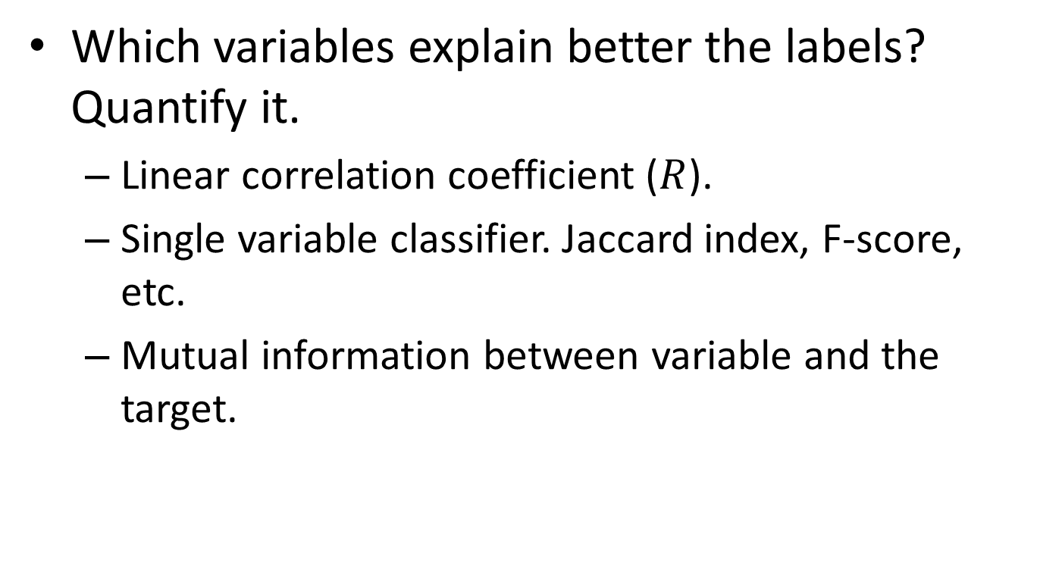
Techniques for Feature Selection (1) Variable Ranking
Which variables explain better the labels? Quantify it.
Linear correlation coefficient ($R$).
Single variable classifier. Jaccard index, F-score, etc.
Mutual information between variable and the target.

Slide 16
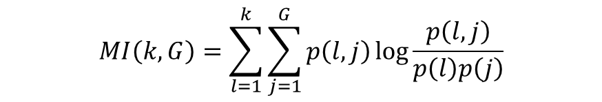
Techniques for Feature Selection (1) Information Theoretic Ranking
$$MI\left(k,G\right)=\sum_{l=1}^{k}{\sum_{j=1}^{G}{p\left(l,j\right)\log{\frac{p\left(l,j\right)}{p\left(l\right)p\left(j\right)}}}}$$
A kind of single variable classifier.
In continuous variables, the sums become integrals
Extensible to continuous variables by non parametric density estimation
Using a Gaussian distribution for estimating the density will lead to a similar criteria to the correlation coefficient.
Is a formalization of the intuition that the higher the joint distribution, the higher the mutual information, i.e. the higher should it be in the rank.

Slide 17
Techniques for Feature Selection (1) Information Theoretic Ranking
The probabilities, in a discrete case are estimated from frequency counts.
Imagine a three class problem (red, green, blue) with a discrete variable that can take 4 values (A,B,C,D).
P(y) are 3 frequency counts.
P(x) are 4 frequency counts.
P(x,y) are 12 frequency counts.

Slide 18
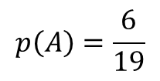
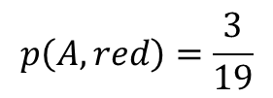
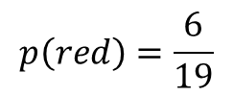
Techniques for Feature Selection (1) Information Theoretic Ranking
A
B
$$p\left(A,red\right)=\frac{3}{19}$$
$$p\left(A\right)=\frac{6}{19}$$
$$p\left(red\right)=\frac{6}{19}$$
C
D

Slide 19
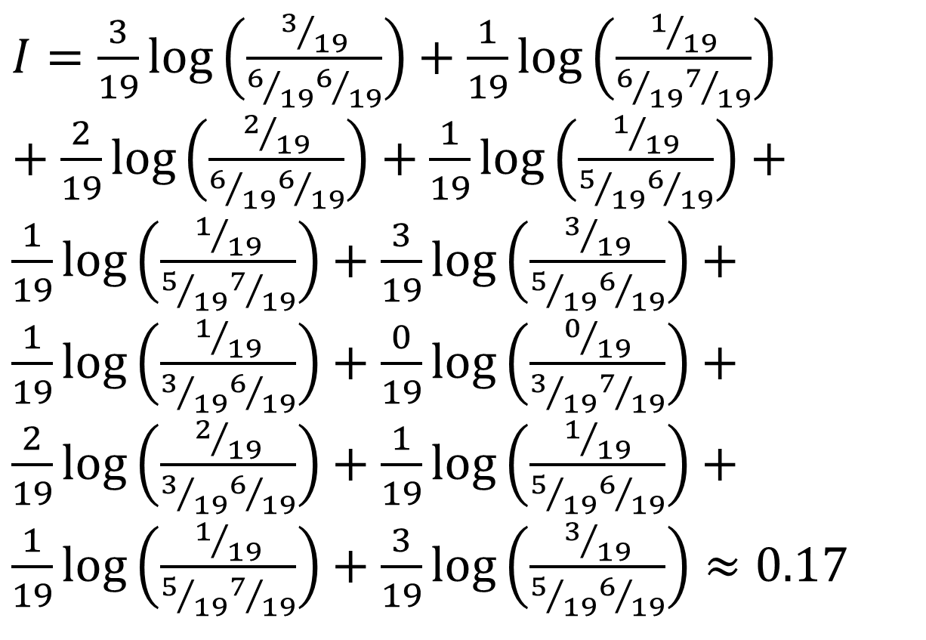
Techniques for Feature Selection (1) Information Theoretic Ranking
A
$I=\frac{3}{19}\log\left(\frac{3/{19}}{6/{19}6/{19}}\right)+\frac{1}{19}\log\left(\frac{1/{19}}{6/{19}7/{19}}\right)$ $+\frac{2}{19}\log\left(\frac{2/{19}}{6/{19}6/{19}}\right)+\frac{1}{19}\log\left(\frac{1/{19}}{5/{19}6/{19}}\right)+\frac{1}{19}\log\left(\frac{1/{19}}{5/{19}7/{19}}\right)+\frac{3}{19}\log\left(\frac{3/{19}}{5/{19}6/{19}}\right)+\frac{1}{19}\log\left(\frac{1/{19}}{3/{19}6/{19}}\right)+\frac{0}{19}\log\left(\frac{0/{19}}{3/{19}7/{19}}\right)+\frac{2}{19}\log\left(\frac{2/{19}}{3/{19}6/{19}}\right)+\frac{1}{19}\log\left(\frac{1/{19}}{5/{19}6/{19}}\right)+\frac{1}{19}\log\left(\frac{1/{19}}{5/{19}7/{19}}\right)+\frac{3}{19}\log\left(\frac{3/{19}}{5/{19}6/{19}}\right)≈0.17$
B
C
D

Slide 20
Techniques for Feature Selection (1) Some questions about Variable Ranking
How to treat redundant variables?
Redundant variables get the same information but its combination can lead to noise reduction.
Correlation is a measure of redundancy
A variable useless by itself can be useful together with others

Slide 21
Features useful only in combination
A
B

Slide 22
Features useful only in combination: which combination of A and B will be useful for separate the two clusters?
A
B

Slide 23
Techniques for Feature Selection (2) Subset selection
Wrappers: Use the predicting power of a given learning machine to assess the usefulness of a given subset
How to search the space? (Brute force is NP hard.)
How to assess the performance of the prediction?
Which learning machine shall we use?
Notes:
Explain better the wrappers

Slide 24
What if we don’t have a response function?
Dimensionality Reduction

Slide 25
Dimensionality Reduction
Summer School on Machine Learning in the Molecular Sciences

Slide 26
Techniques for Dim. reduction
Dimensionality Reduction
Convex
Euclidean Distance
Geodesic Distance
Non-Convex
Neural Network
Kernel –Based
Full Spectral
Diffusion Distance
Sparse spectral
Reconstruction Weights
Neighborhood graph Laplacian
Local Tangent space
Weighted Euclidean distances
Alignment of local linear modes
Isomap
PCA
Kernel PCA
Diffusion Maps
LLE
Laplacian Eigenmaps
Hessian LLE
Sammon Mapping
LLC Man. Charting
Autoencoder
Van Der Maaten, L., Postma, E., & Van den Herik, J. (2009). Dimensionality reduction: a comparative. J Mach Learn Res, 10, 66-71.

Slide 27
2nd Principal
Component, u₂
1st Principal
Component, u₁
Notes:
Look for notation

Slide 28
PCA Scores
x_{i2}
y_{i,1}
y_{i,2}
x_{i1}

Slide 29
PCA Eigenvalues
λ₂
λ₁

Slide 30
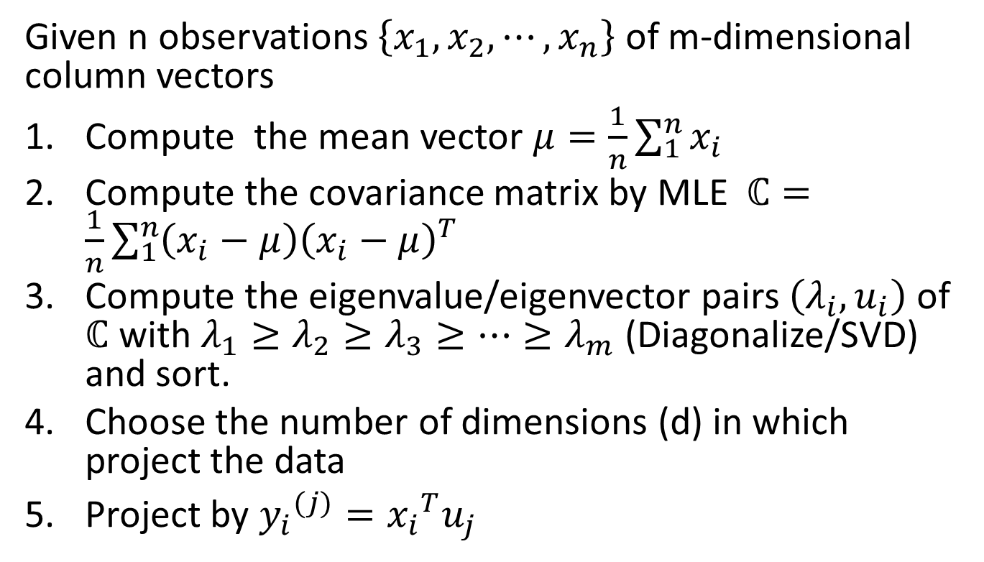
PCA. How to…
Given n observations $\left\{x_{1},x_{2},⋯,x_{n}\right\}$ of m-dimensional column vectors
Compute the mean vector $μ=\frac{1}{n}\sum_{1}^{n}{x_{i}}$
Compute the covariance matrix by MLE $ℂ=\frac{1}{n}\sum_{1}^{n}{\left(x_{i}−μ\right){\left(x_{i}−μ\right)}^{T}}$
Compute the eigenvalue/eigenvector pairs $\left(λ_{i},u_{i}\right)$ of $ℂ$ with $λ_{1}≥λ_{2}≥λ_{3}≥…≥λ_{m}$ (Diagonalize/SVD) and sort.
Choose the number of dimensions (d) in which project the data
Project by ${y_{i}}^{(j)}={x_{i}}^{T}u_{j}$

Slide 31
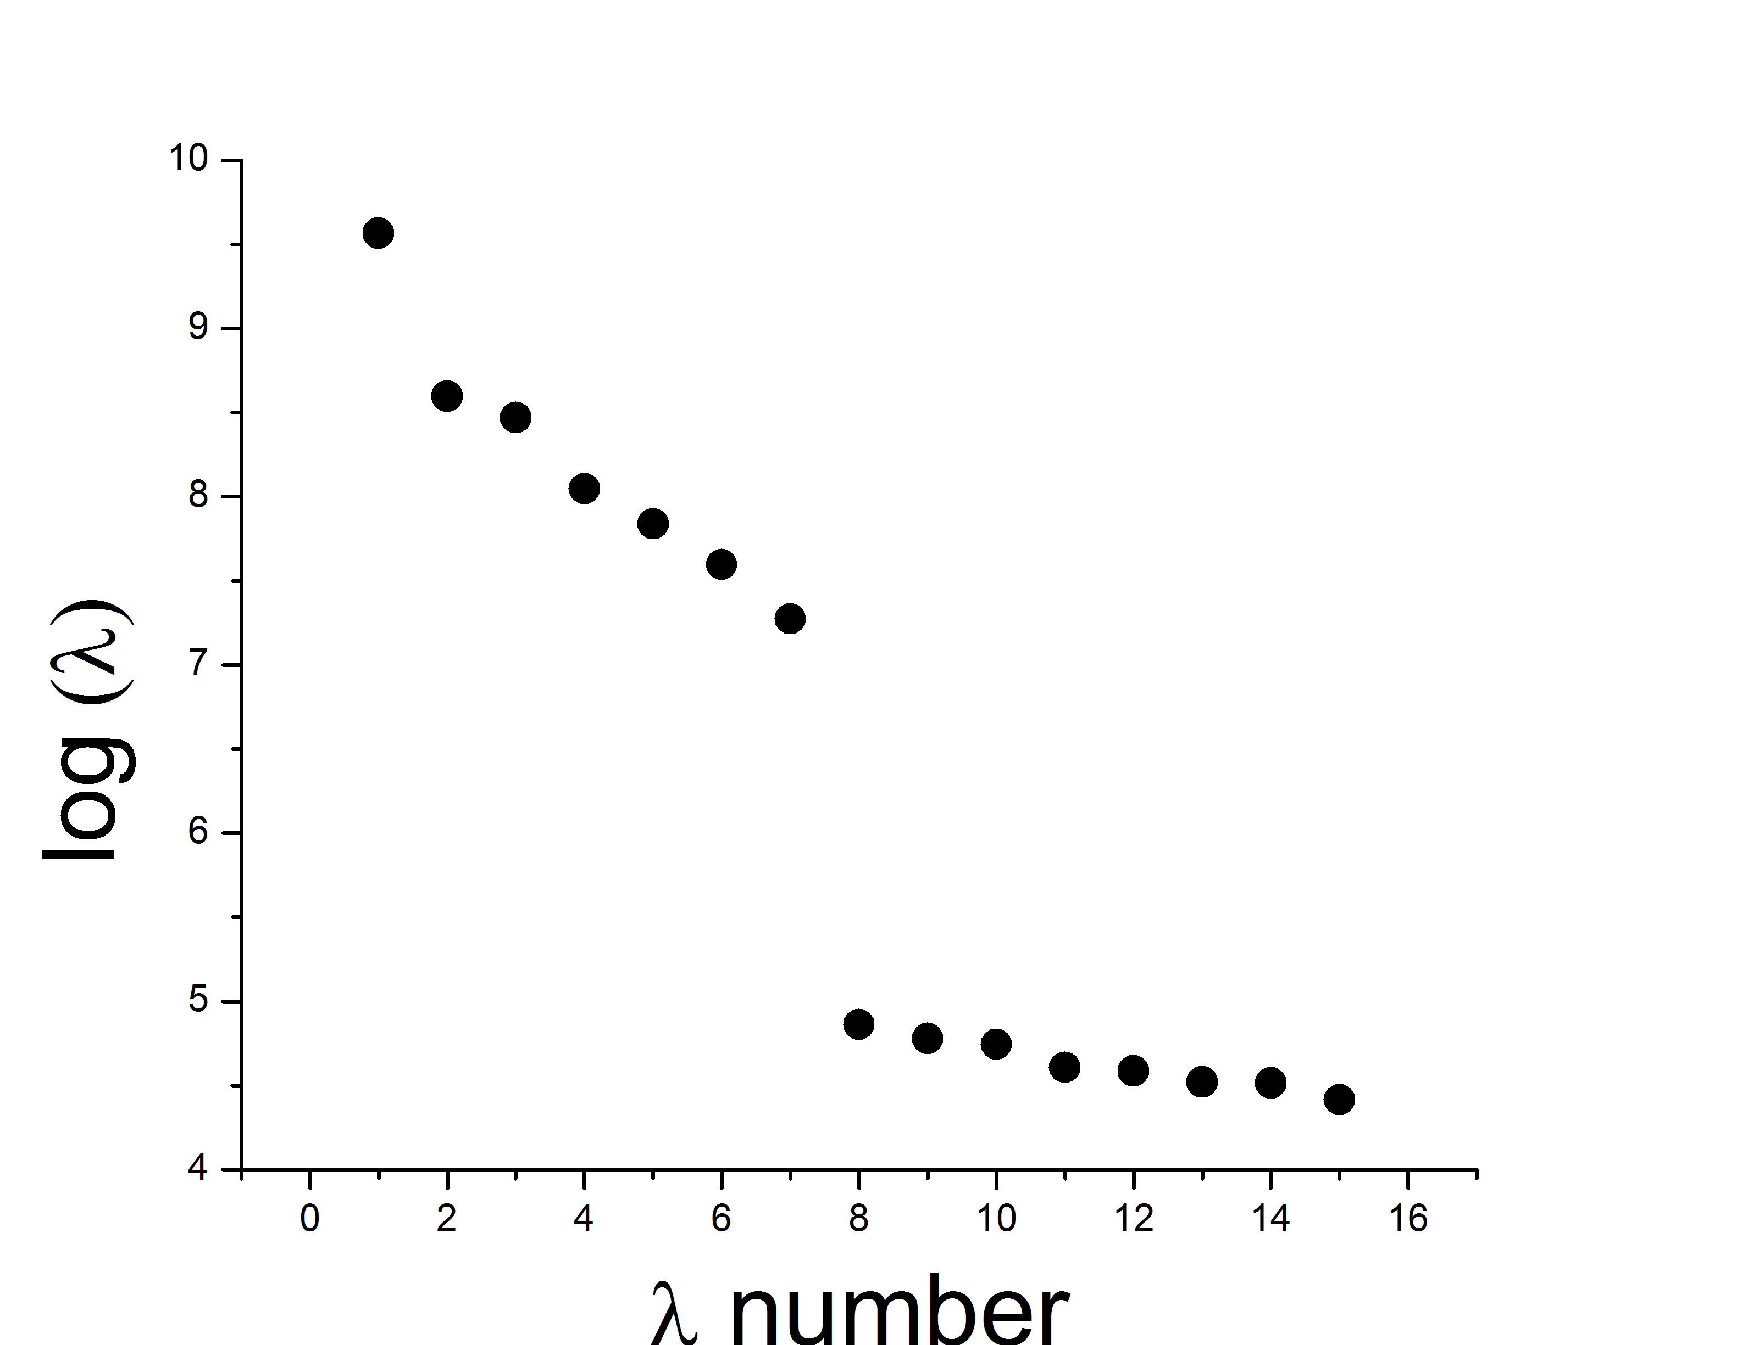
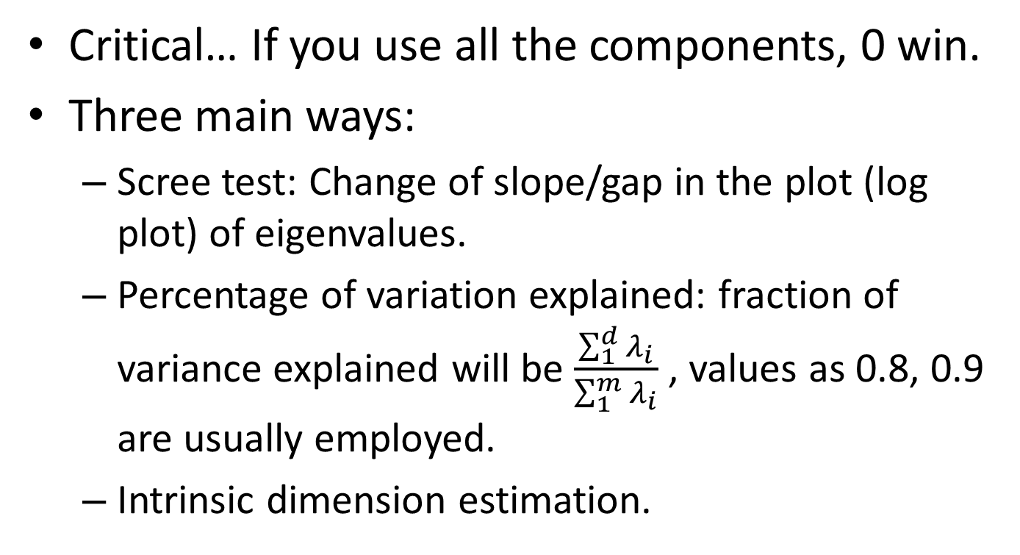
Choosing the number of PC’s
Critical… If you use all the components, 0 win.
Three main ways:
Scree test: Change of slope/gap in the plot (log plot) of eigenvalues.
Percentage of variation explained: fraction of variance explained will be $\frac{\sum_{1}^{d}{λ_{i}}}{\sum_{1}^{m}{λ_{i}}}$ , values as 0.8, 0.9 are usually employed.
Intrinsic dimension estimation.

Slide 32
Similarities and distances
Summer School on Machine Learning in the Molecular Sciences

Slide 33
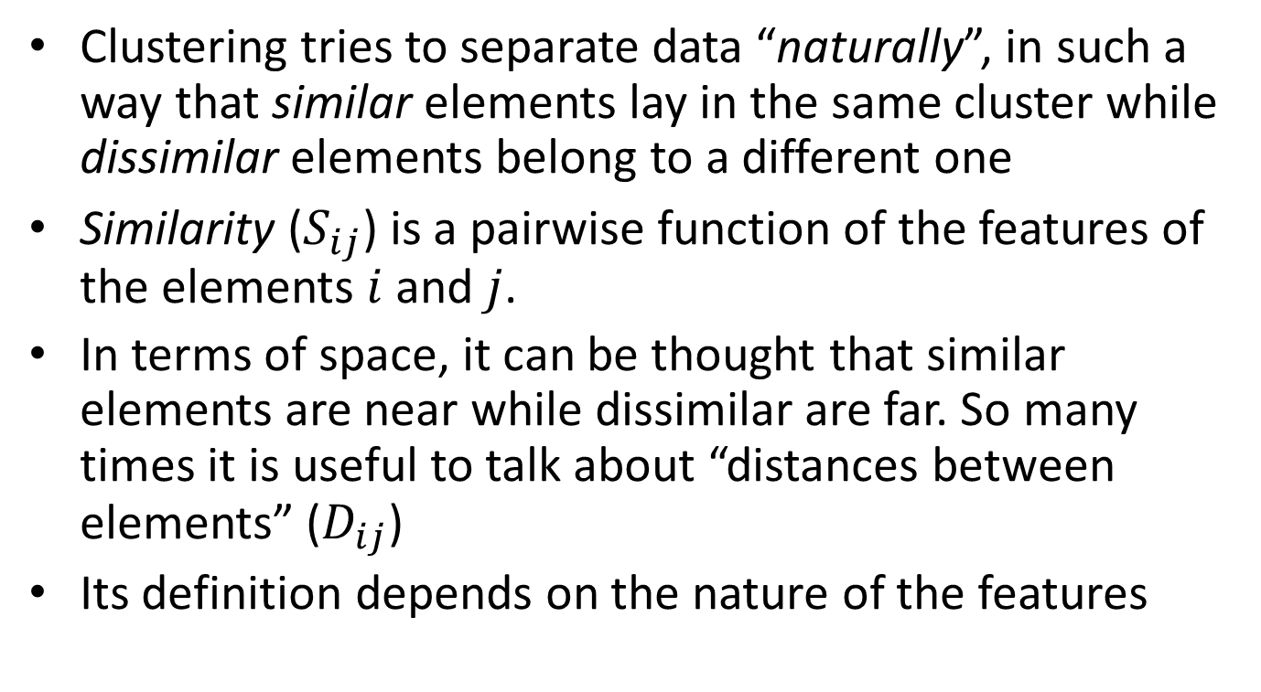
Similarity and Distances
Clustering tries to separate data “naturally”, in such a way that similar elements lay in the same cluster while dissimilar elements belong to a different one
Similarity ($S_{ij}$) is a pairwise function of the features of the elements $i$ and $j$.
In terms of space, it can be thought that similar elements are near while dissimilar are far. So many times it is useful to talk about “distances between elements” ($D_{ij}$)
Its definition depends on the nature of the features

Slide 34
Similarity and Distances almost the same but…
A (metric) distance must accomplish:
Symmetry: d(x, y) = d(y, x)
Non-negativity: d(x, y) ≥ 0
Identity of indiscernibles: d(x, y) = 0 ⇔ x = y
Triangle inequality: d(x, z) + d(z, y) ≥ d(x, y)
We have to take this into account for some clustering algorithms

Slide 35
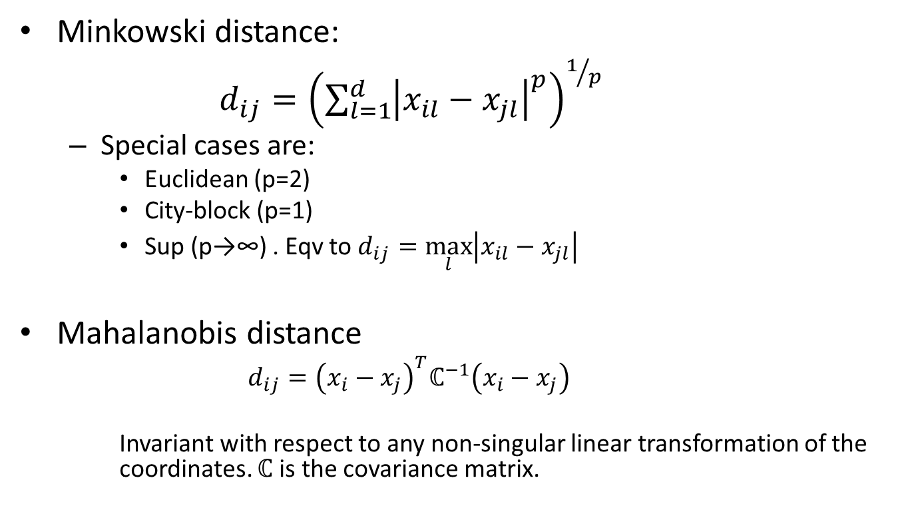
Quantitative Features: Metric Distances
Minkowski distance:
$d_{ij}={\left(\sum_{l=1}^{d}{{\left|x_{il}−x_{jl}\right|}^{p}}\right)}^{1/p}$
Special cases are:
Euclidean (p=2)
City-block (p=1)
Sup (p→∞) . Eqv to $d_{ij}=\max_{l}\left|x_{il}−x_{jl}\right|$
Mahalanobis distance
$$d_{ij}={\left(x_{i}−x_{j}\right)}^{T}ℂ^{−1}\left(x_{i}−x_{j}\right)$$
Invariant with respect to any non-singular linear transformation of the coordinates. $ℂ$ is the covariance matrix.

Slide 36
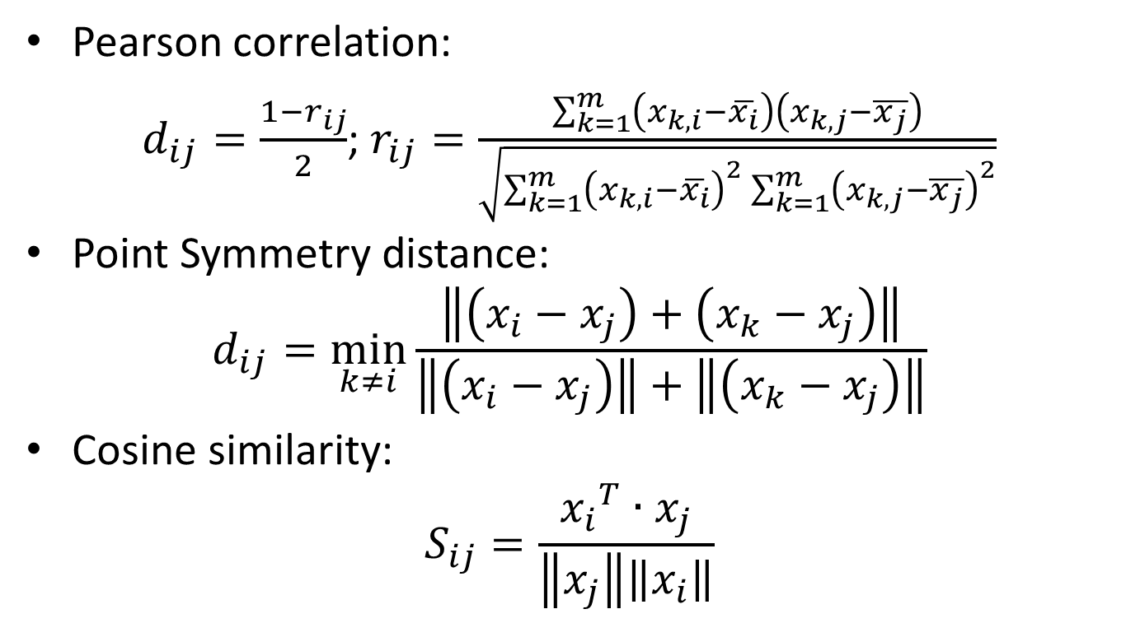
Quantitative Features: Not metric distances
Pearson correlation:
$d_{ij}=\frac{1−r_{ij}}{2}$; $r_{ij}=\frac{\sum_{k=1}^{m}{\left(x_{k,i}−\overline{x_{i}}\right)\left(x_{k,j}−\overline{x_{j}}\right)}}{\sqrt{\sum_{k=1}^{m}{{\left(x_{k,i}−\overline{x_{i}}\right)}^{2}\sum_{k=1}^{m}{{\left(x_{k,j}−\overline{x_{j}}\right)}^{2}}}}}$
Point Symmetry distance:
$$d_{ij}=\min_{k≠i}{\frac{\left\|\left(x_{i}−x_{j}\right)+\left(x_{k}−x_{j}\right)\right\|}{\left\|\left(x_{i}−x_{j}\right)\right\|+\left\|\left(x_{k}−x_{j}\right)\right\|}}$$
Cosine similarity:
$$S_{ij}=\frac{{x_{i}}^{T}∙x_{j}}{\left\|x_{j}\right\|\left\|x_{i}\right\|}$$
Notes:
Eliminar point symmetry distance???

Slide 37
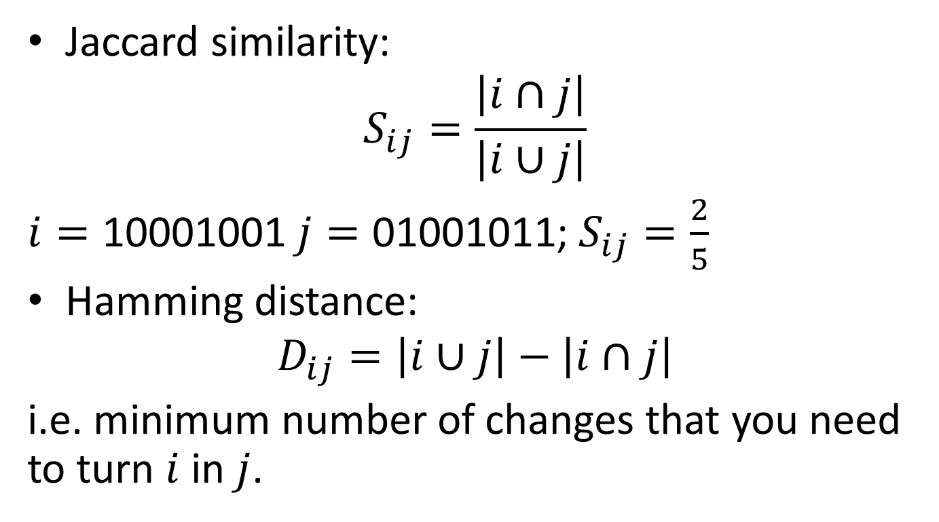
Qualitative Features
Jaccard similarity:
$$S_{ij}=\frac{\left|i∩j\right|}{\left|i∪j\right|}$$
$i=\text{10001001}$ $j=\text{01001011}$; $S_{ij}=\frac{2}{5}$
Hamming distance:
$$D_{ij}=\left|i∪j\right|−\left|i∩j\right|$$
i.e. minimum number of changes that you need to turn $i$ in$j$.
Notes:
Look for the general formula for Jaccard Similarity

Slide 38
More complicated distances
Working in the metric can extremely simplify the clustering work.
A good metric can dramatically improve the performance of an algorithm.
However, usually they need to compute a simplest distance as starting point.
Example: Geodesic distance

Slide 39
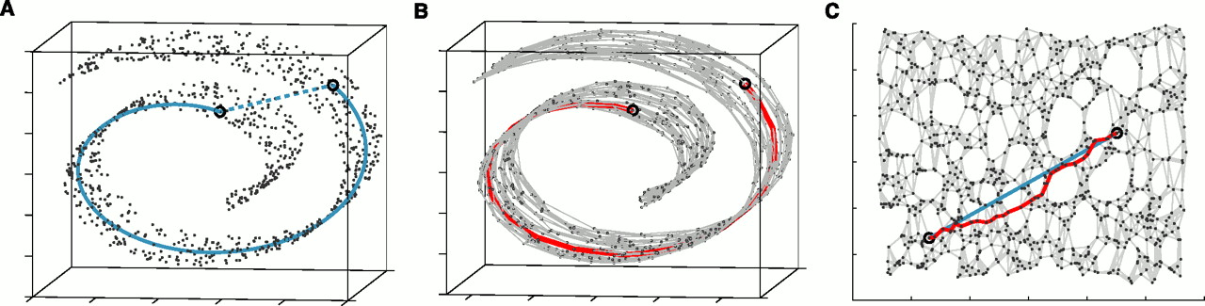
Geodesic distance

Slide 40
Flat, hierarchical and fuzzy clustering
Summer School on Machine Learning in the Molecular Sciences

Slide 41
Clustering procedure
Cardinality, Dimension, type
Feature ranking,
PCA, distances
Data Samples
Feature Selection (objective related)
Clustering
Knowledge
Interpretation (Expertise)
Validation (are the groups meaningful?)

Slide 42
What is a cluster (revisited)

Slide 43
What is a cluster (revisited)

Slide 44
What is a cluster (revisited)

Slide 45
What is a cluster (revisited)

Slide 46
What is a cluster (revisited)

Slide 47
What is a cluster (revisited)

Slide 48
What is a cluster (revisited)

Slide 49

Some consideration about Clustering
Tautology: the result of the clustering process depends on your cluster definition
And it depends on the metric
And it also depends on the features that you have chosen

Slide 50
Flat, fuzzy and hierarchical clustering
Flat clustering performs a hard partition of the data
Fuzzy clustering is a flat clustering algorithm with soft element assignation
Hierarchical clustering generates a tree instead of a single partition. Can be agglomerative (joining elements) or divisive (dividing the dataset)

Slide 51
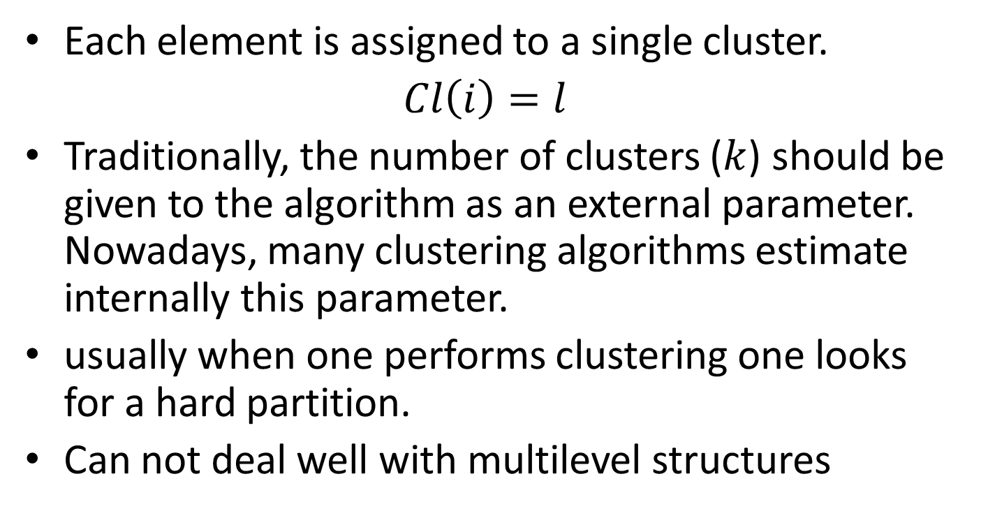
Flat clustering
Each element is assigned to a single cluster.
$Cl\left(i\right)=l$
Traditionally, the number of clusters ($k$) should be given to the algorithm as an external parameter. Nowadays, many clustering algorithms estimate internally this parameter.
usually when one performs clustering one looks for a hard partition.
Can not deal well with multilevel structures

Slide 52
Flat clustering
5
1
3
2
4

Slide 53
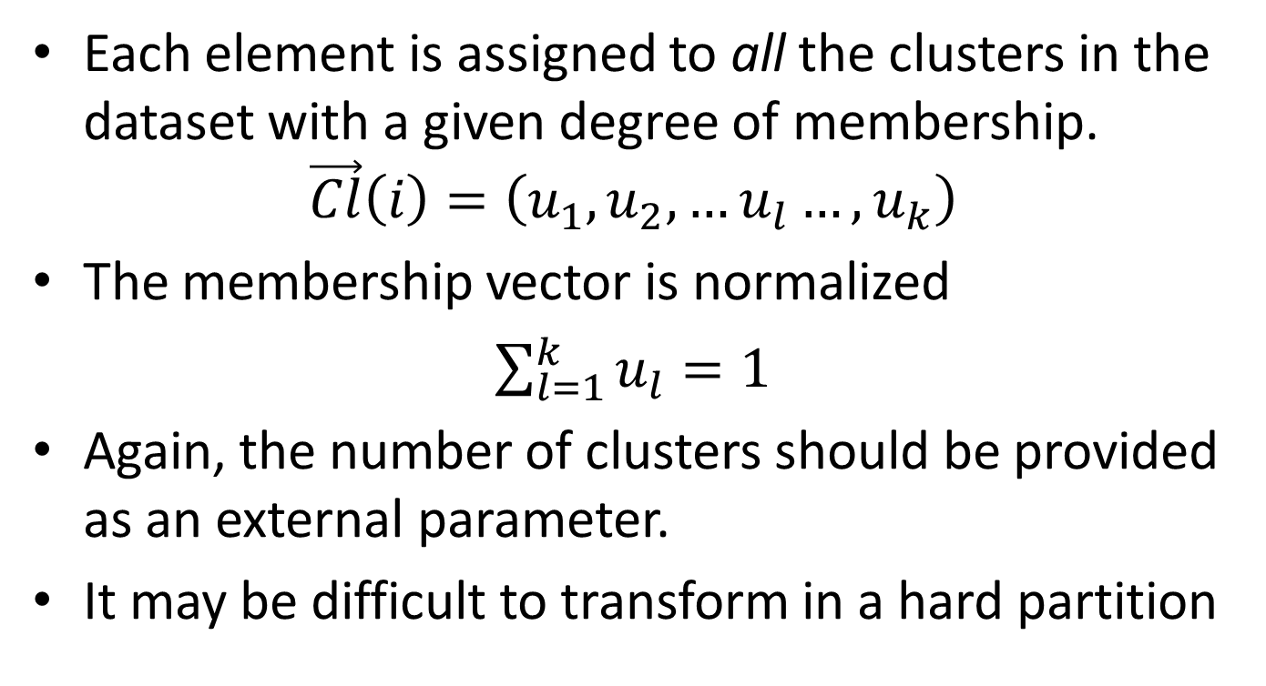
Fuzzy clustering
Each element is assigned to all the clusters in the dataset with a given degree of membership.
$$\vec{Cl}\left(i\right)=\left(u_{1},u_{2},…u_{l}…,u_{k}\right)$$
The membership vector is normalized
$\sum_{l=1}^{k}{u_{l}}=1$
Again, the number of clusters should be provided as an external parameter.
It may be difficult to transform in a hard partition

Slide 54
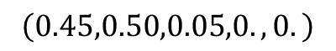
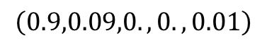
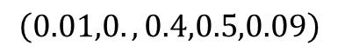
Fuzzy clustering
$$\left(0.9,0.09,0.,0.,0.01\right)$$
$$\left(0.01,0.,0.4,0.5,0.09\right)$$
$$\left(0.45,0.50,0.05,0.,0.\right)$$

Slide 55
Hierarchical clustering
Produces a set of nested clusters organized as a hierarchical tree
Can be visualized as a dendrogram (A tree-like diagram that records the sequences of merges or splits)
No assumptions on the number of clusters
Hierarchical clusterings may correspond to meaningful taxonomies
It can be transformed in many hard partitions

Slide 56
Hierarchical clustering

Slide 57
Flattening the hierarchical clustering

Slide 58
K-means: A flat clustering algorithm
MacQueen, J. (1967, June). Some methods for classification and analysis of multivariate observations. In Proceedings of the fifth Berkeley symposium on mathematical statistics and probability (Vol. 1, No. 14, pp. 281-297).*
*~20000 cites!!!

Slide 59
K-means clustering
Attempts to minimize the intracluster distance while maximizing the intercluster distance.
It is based on the concept of cluster centroid, i.e. the average position of the cluster elements.
Still widely used.
It can be easily parallelized and linearized.
User must provide k

Slide 60
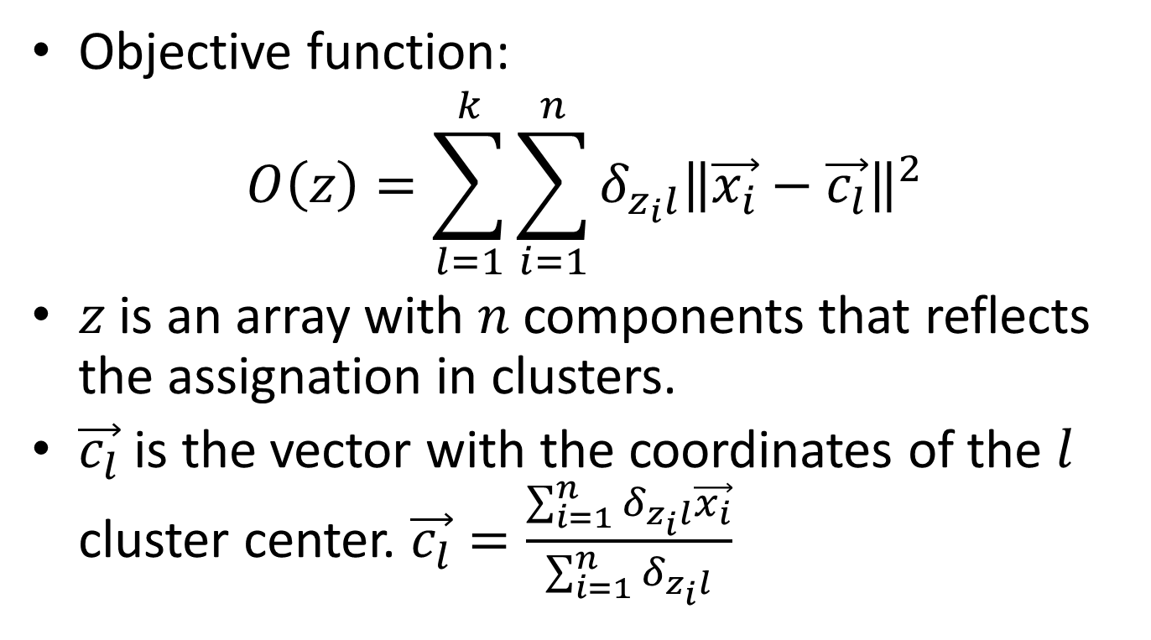
K-means objective function
Objective function:
$$O\left(z\right)=\sum_{l=1}^{k}{\sum_{i=1}^{n}{δ_{z_{i}l}{\left\|\vec{x_{i}}−\vec{c_{l}}\right\|}^{2}}}$$
$z$is an array with $n$ components that reflects the assignation in clusters.
$\vec{c_{l}}$ is the vector with the coordinates of the $l$ cluster center. $\vec{c_{l}}=\frac{\sum_{i=1}^{n}{δ_{z_{i}l}\vec{x_{i}}}}{\sum_{i=1}^{n}{δ_{z_{i}l}}}$

Slide 61
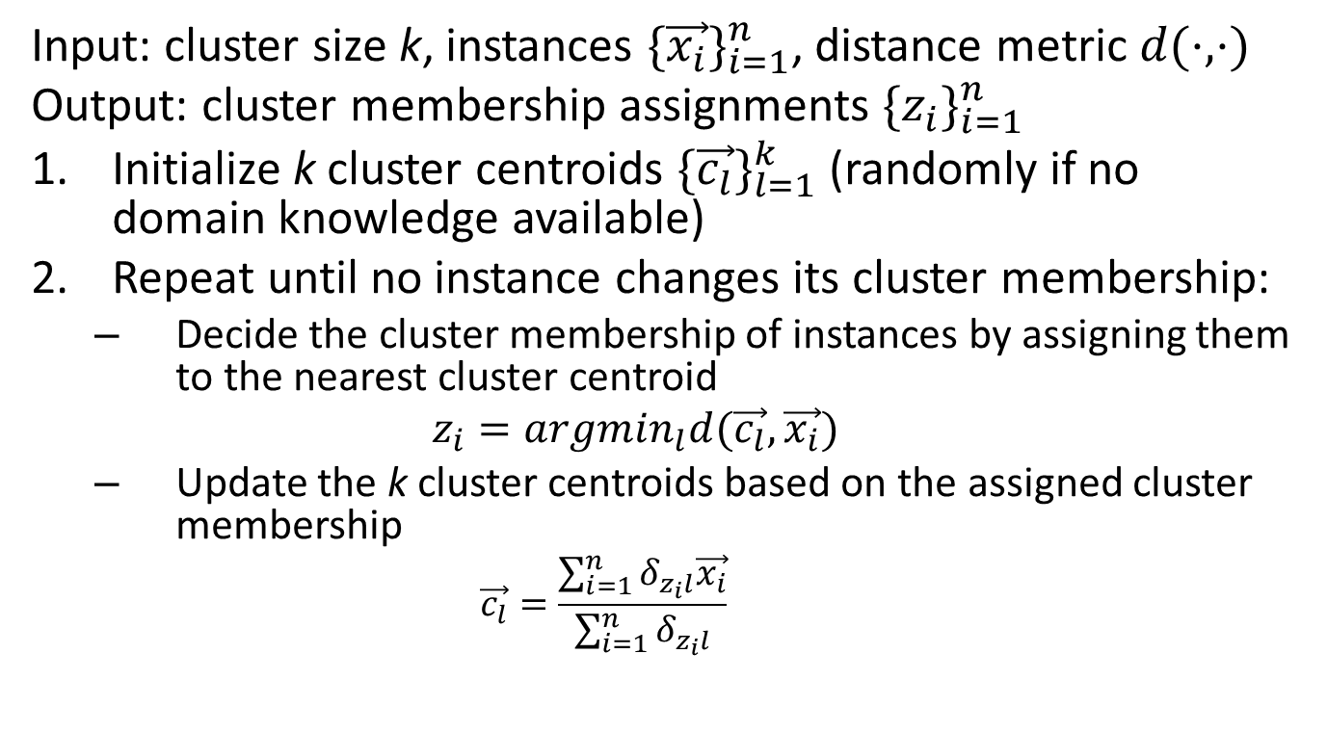
k-means algorithm
Input: cluster size k, instances ${\{\vec{x_{i}}\}}_{i=1}^{n}$, distance metric $d(⋅,⋅)$
Output: cluster membership assignments ${\{z_{i}\}}_{i=1}^{n}$
Initialize k cluster centroids ${\{\vec{c_{l}}\}}_{l=1}^{k}$ (randomly if no domain knowledge available)
Repeat until no instance changes its cluster membership:
Decide the cluster membership of instances by assigning them to the nearest cluster centroid
$$z_{i}=argmin_{l}d(\vec{c_{l}},\vec{x_{i}})$$
Update the k cluster centroids based on the assigned cluster membership
$$\vec{c_{l}}=\frac{\sum_{i=1}^{n}{δ_{z_{i}l}\vec{x_{i}}}}{\sum_{i=1}^{n}{δ_{z_{i}l}}}$$
Minimize intra distance
Maximize inter distance

Slide 62
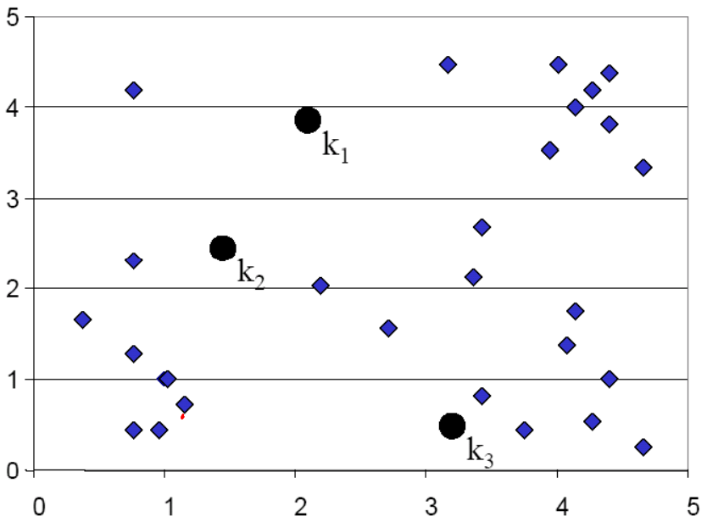
k-means illustration

Slide 63
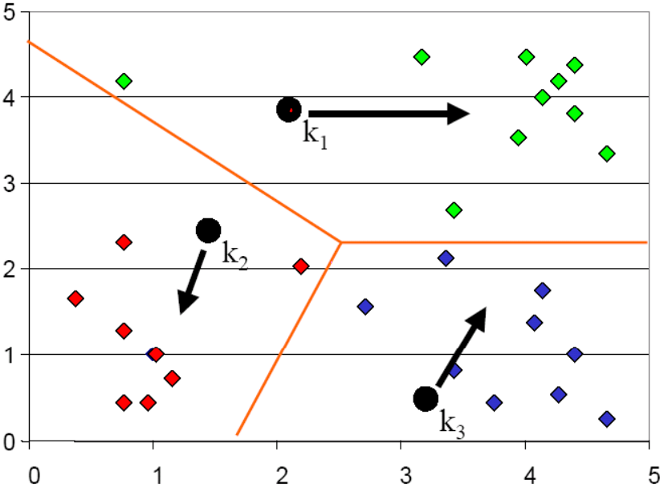
k-means illustration
Voronoi diagram

Slide 64
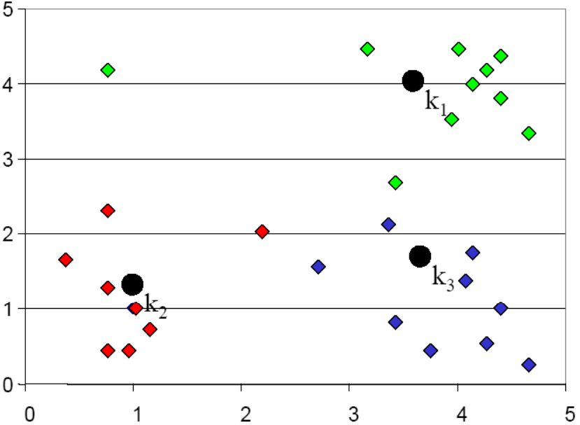
k-means illustration

Slide 65
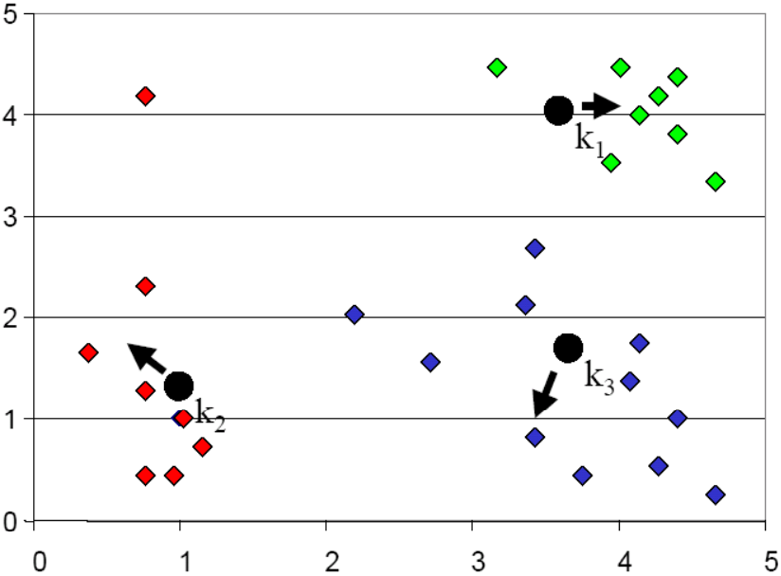
k-means illustration

Slide 66
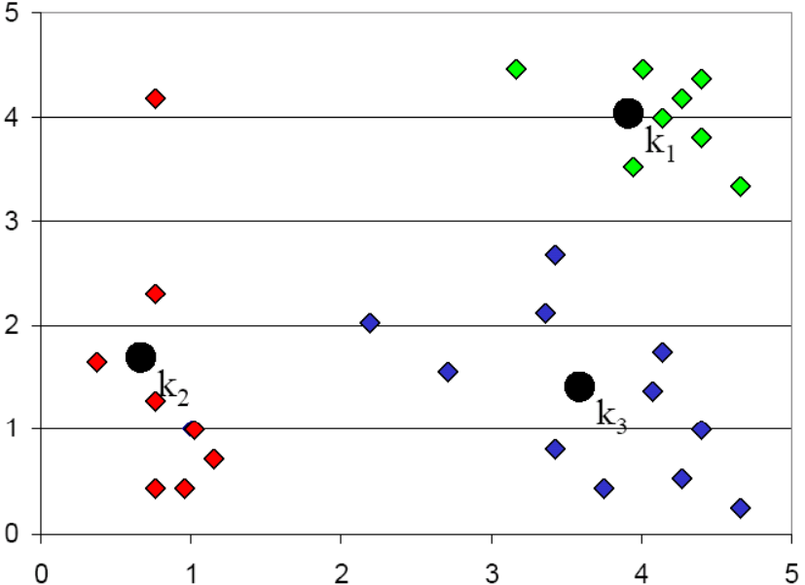
k-means illustration

Slide 67
K-means weakness
Initialization sensitive (local optimization) →k-means++
Which k-employing →Scree test
Sensitive to outliers →k-medoids
employs Euclidean distance →k-medoids
Only for spherical clusters →kernel k-means (advanced)

Slide 68
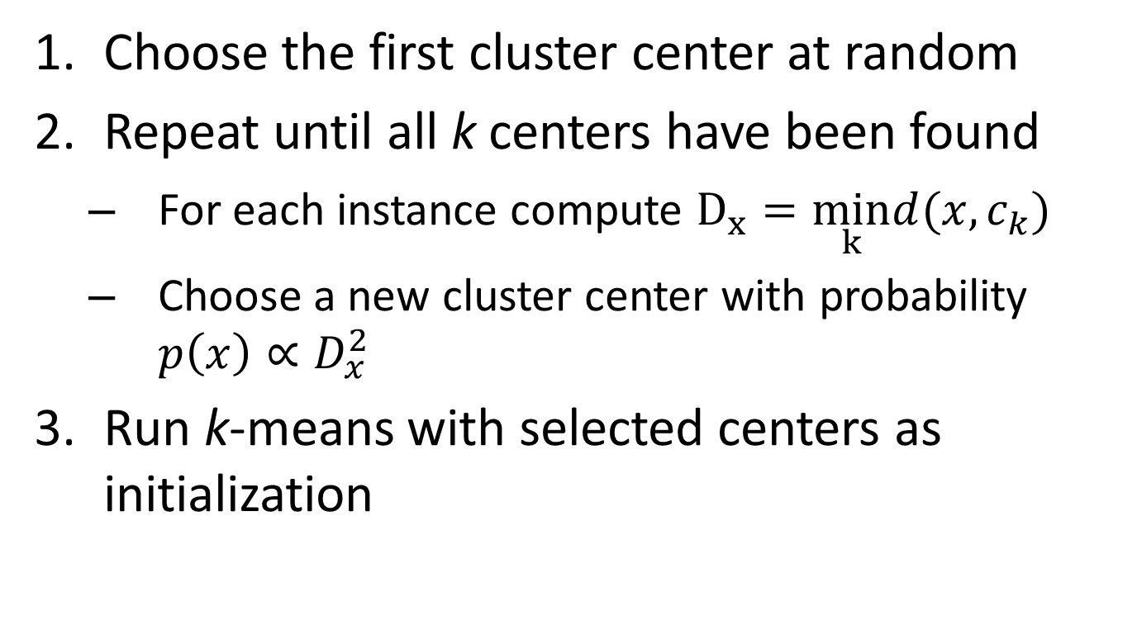
Better initialization: k-means++
Choose the first cluster center at random
Repeat until all k centers have been found
For each instance compute $D_{x}=\min_{k}d(x,c_{k})$
Choose a new cluster center with probability $p\left(x\right)∝D_{x}^{2}$
Run k-means with selected centers as initialization
new center should be far away from existing centers

Slide 69
Scree test for k-means
The best K is 3.
Dissimilarity
1
2
3
4
5
6
7
Number of Clusters

Slide 70
K-medoids
It can be used with all kind of distances.
Reduces the impact of outliers.
Instead of working with centroids, it works with medoids, i.e. the most central element of the cluster.
The cluster medoid is the element with minimum sum of distances to the rest of the elements of the cluster

Slide 71
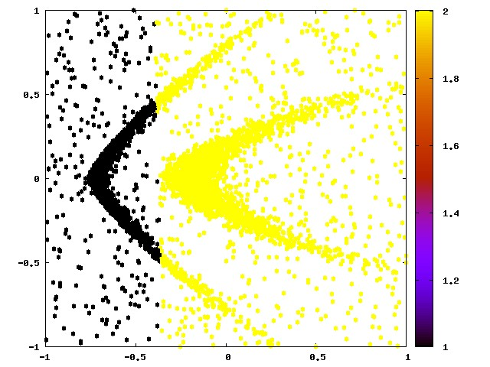
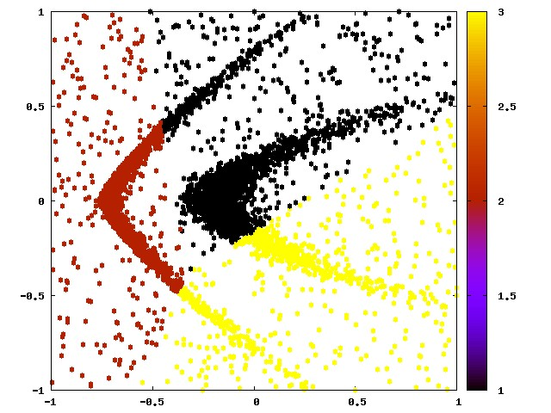
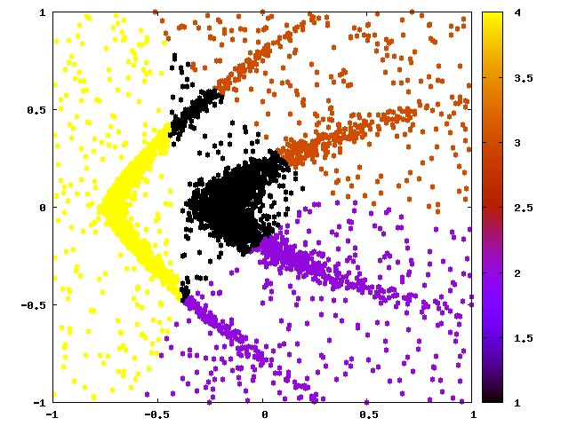
K=2
K=3
K=4

